Slide 1



git and GitHub on Rstudio without the command line
Pedro Neves

Slide 2
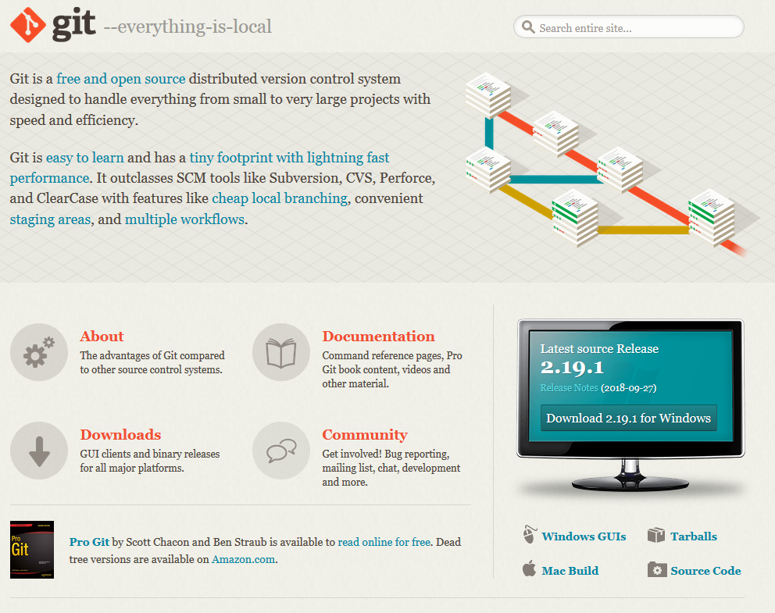
Installing git

Slide 3
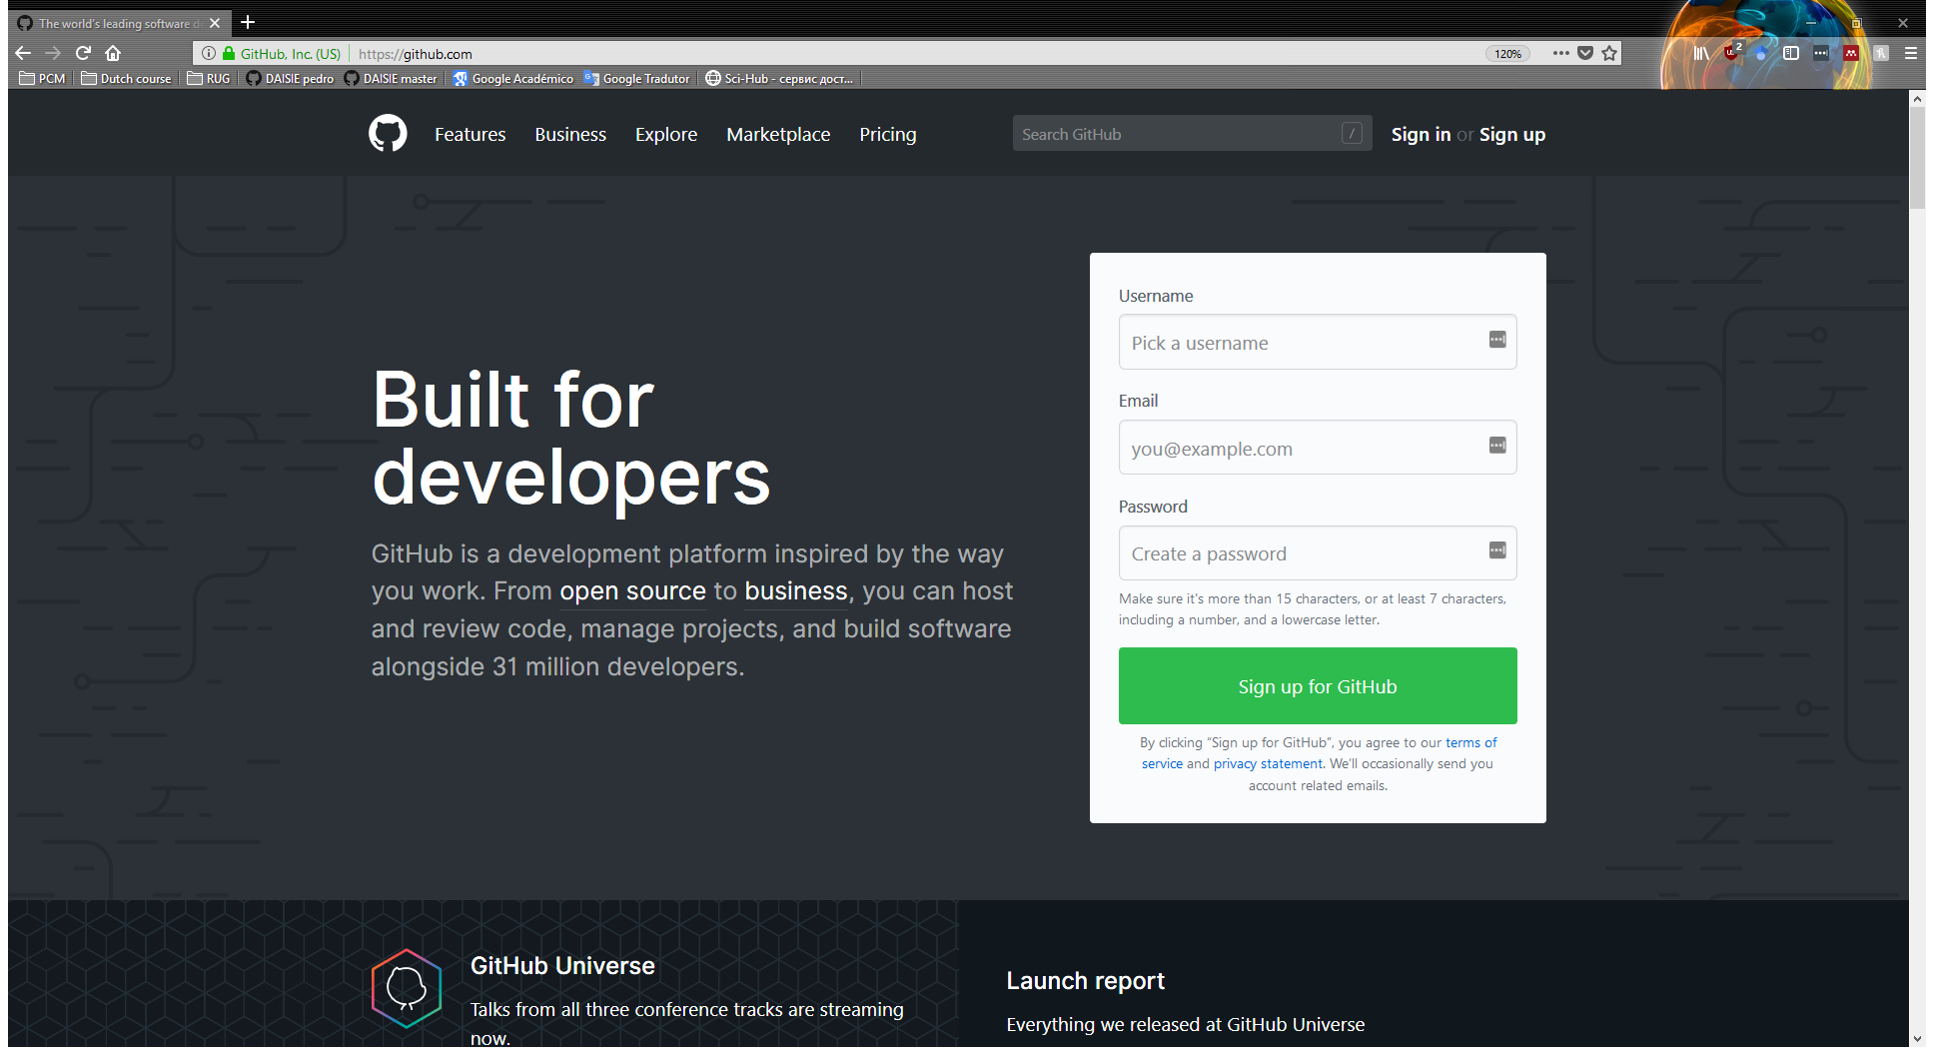
Getting a GitHub account

Slide 4
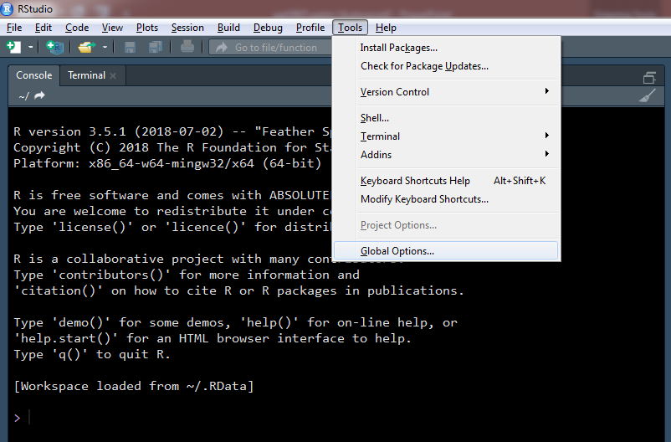
Setting up git in RStudio

Slide 5
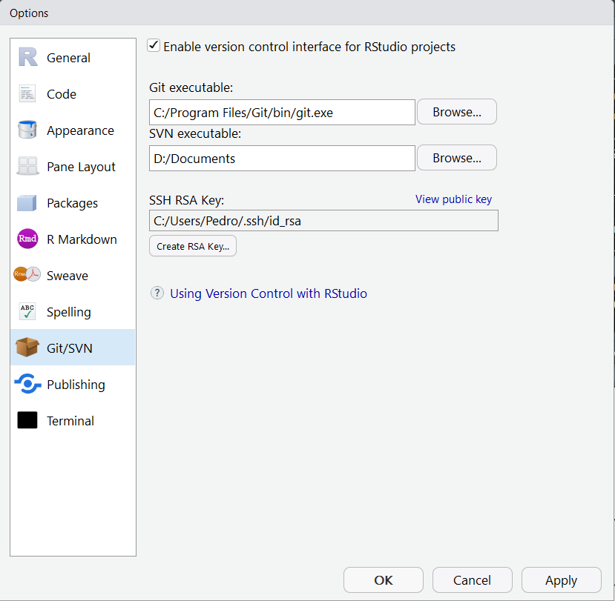
Enabling git
Make sure the path to git points to Git/bin/git.exe! Not Git/git-bash.exe
The correct path should appear automatically after you install git and enable version control, but occasionally it will point to the wrong location

Slide 6


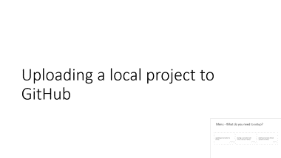



Menu - What do you need to setup?

Slide 7
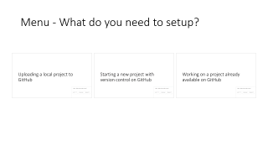
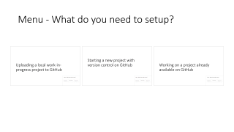
Uploading a local project to GitHub

Slide 8
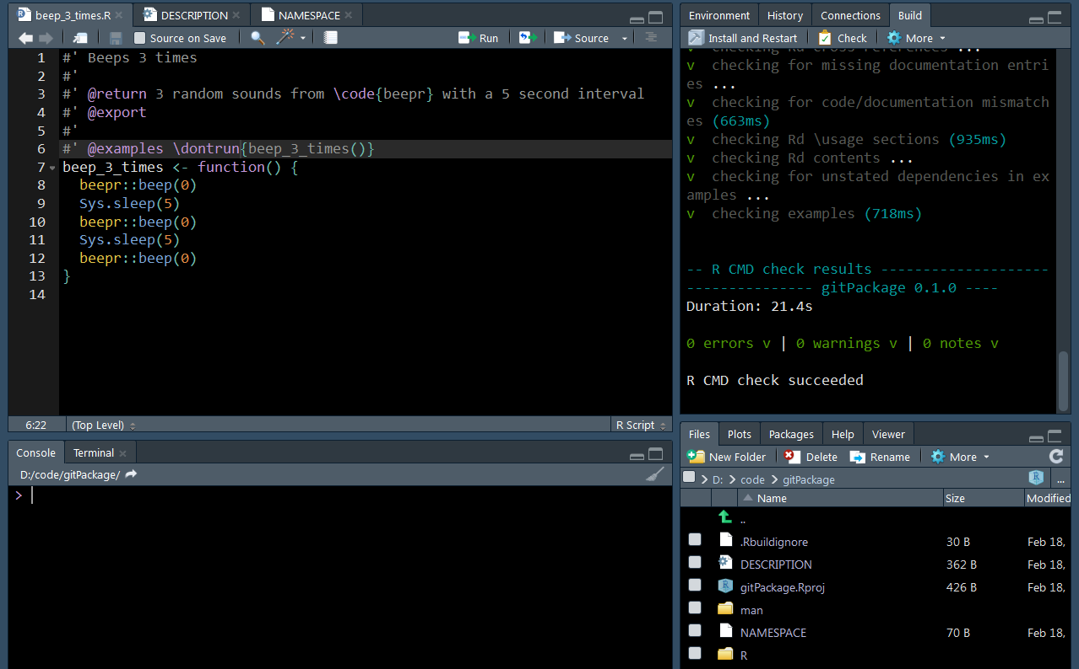
Start with some code

Slide 9
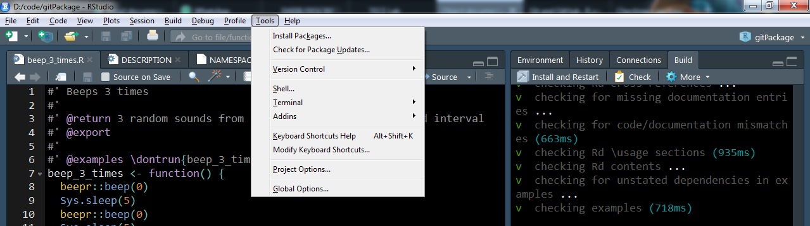

Slide 10
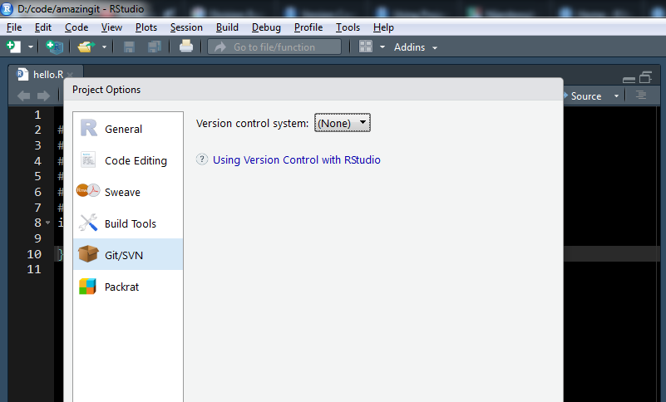
Enabling git on a new project

Slide 11
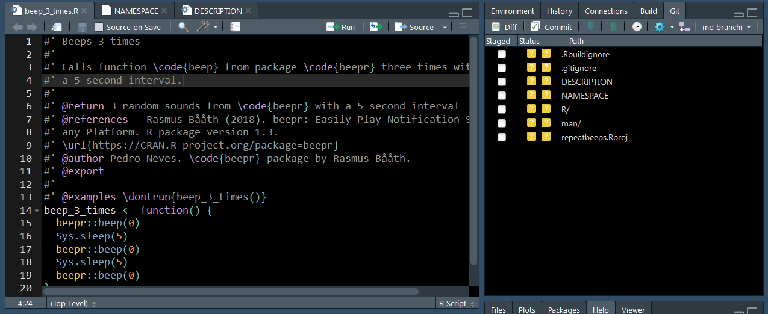
Git panel

Slide 12
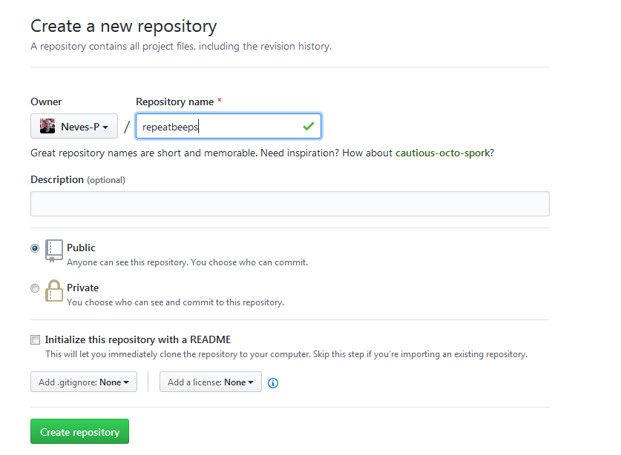
Create repo with same name
Don’t initialize with a README or any other file. We’ll add them later.

Slide 13
Open terminal in R and run the following code
git remote add origin https://github.com/YourUsername/RepoName.git
git add –A
git commit –m “initial commit”
git push –u origin master

Slide 14
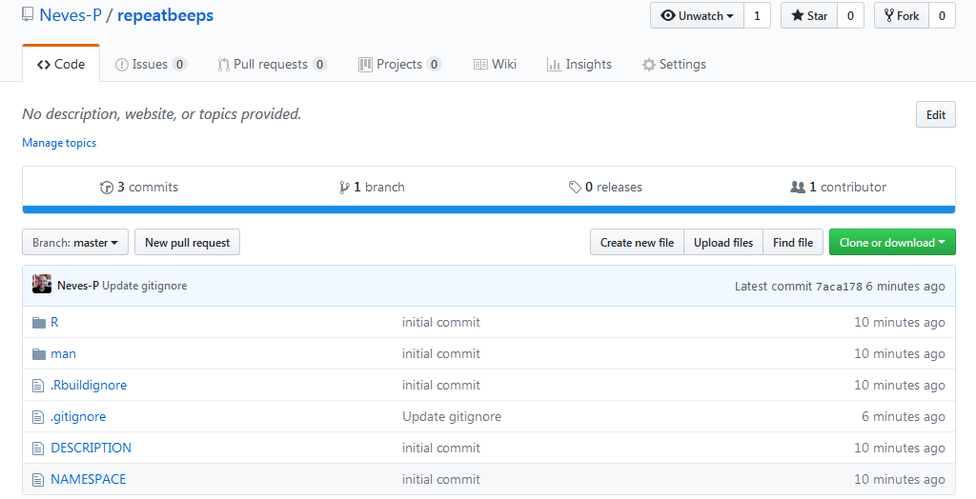
Package now on GitHub

Slide 15
Starting a new project with version control on GitHub

Slide 16
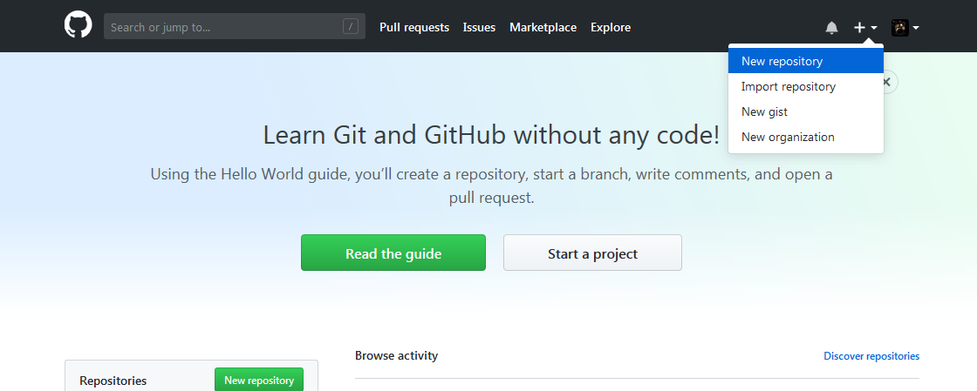

Slide 17
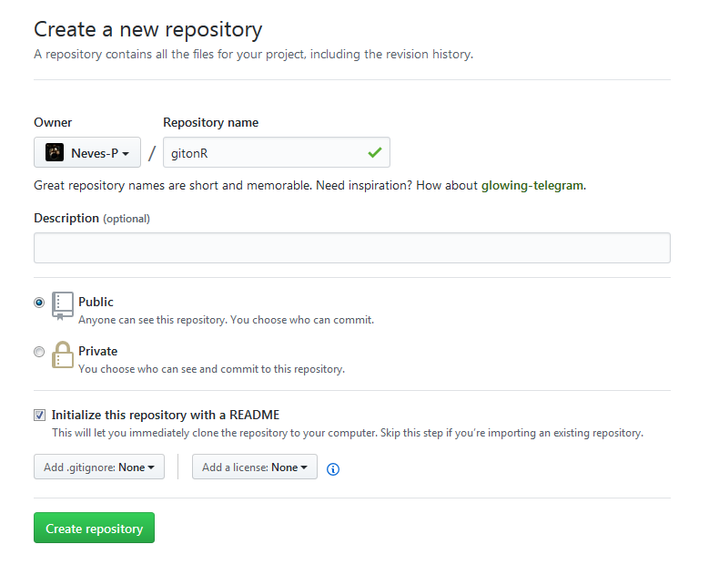
Creating repository on GitHub
Choose a name for the repository and initialize it with a README file.
Keep in mind that R packages must start with a letter and only contain ASCII numbers and letters. Dashes, underscores and slashes are not allowed.
This will let you clone to your local computer right away.

Slide 18
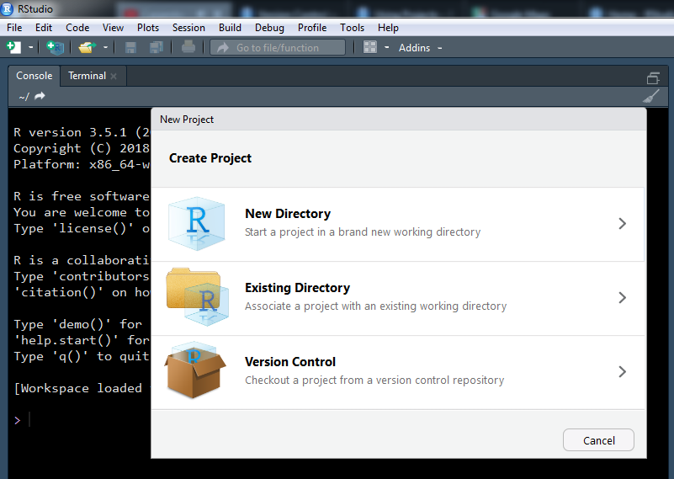
Downloading (cloning) the newly created repository

Slide 19
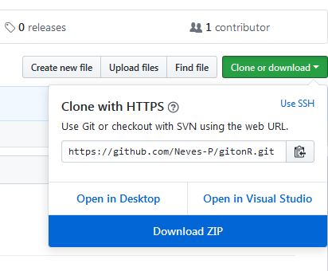
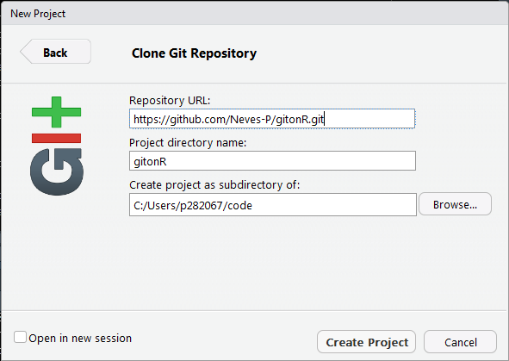
Cloning a repository
Copy your new GitHub repo’s URL to the Clone Git Repository Window in RStudio. GitHub will give you the right address, it should end in .git
Choose a directory on your local computer where the local files will live

Slide 20
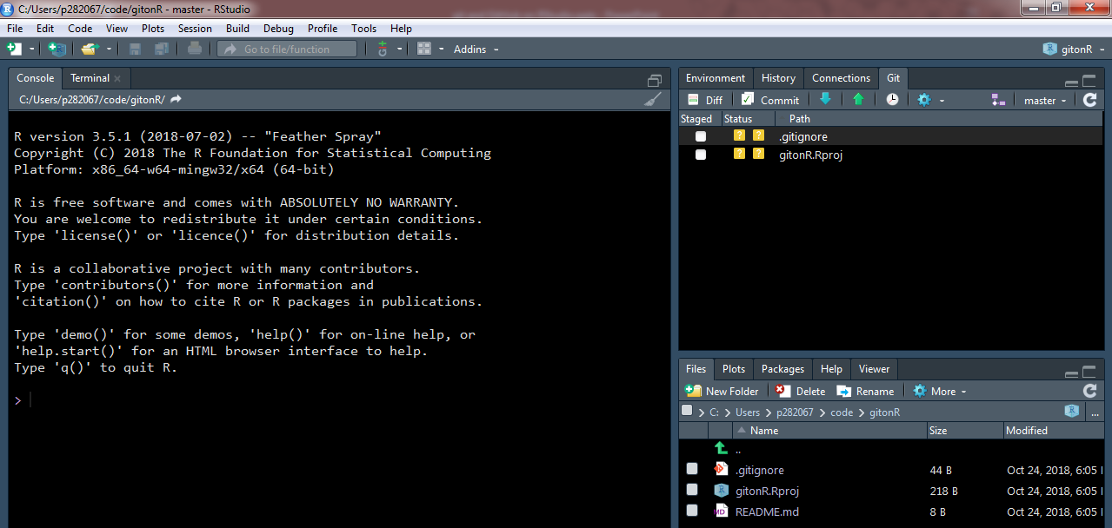
After cloning the repository

Slide 21
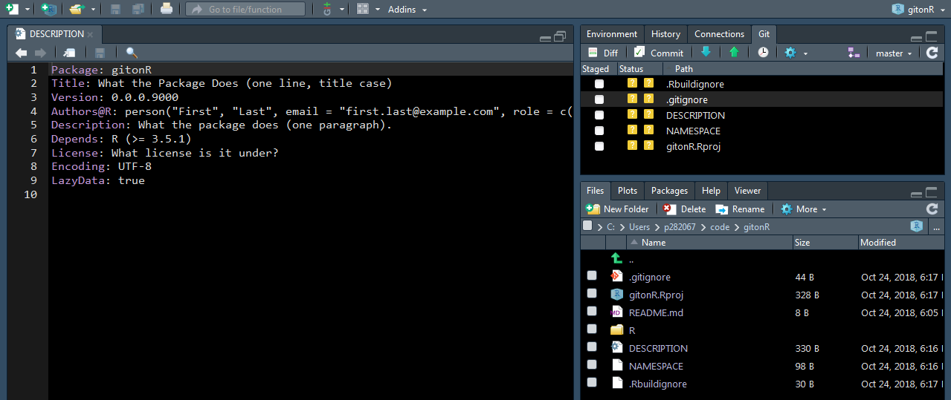
Creating and pushing package skeleton
Package folder structure and temporary files can easily be created by running devtools::setup().
I recommend also running devtools::document() to start documenting with roxygen2

Slide 22
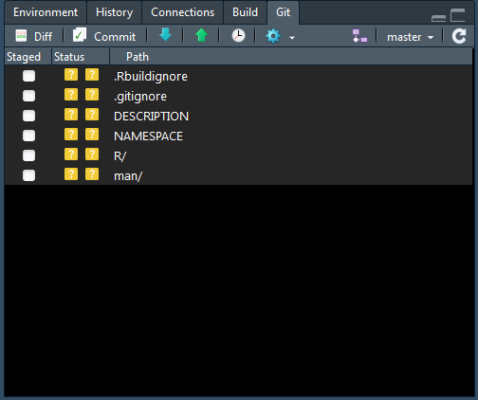
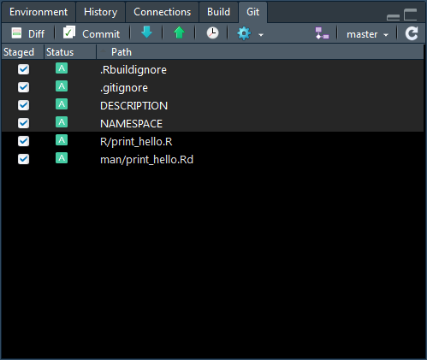
Using git!

Slide 23
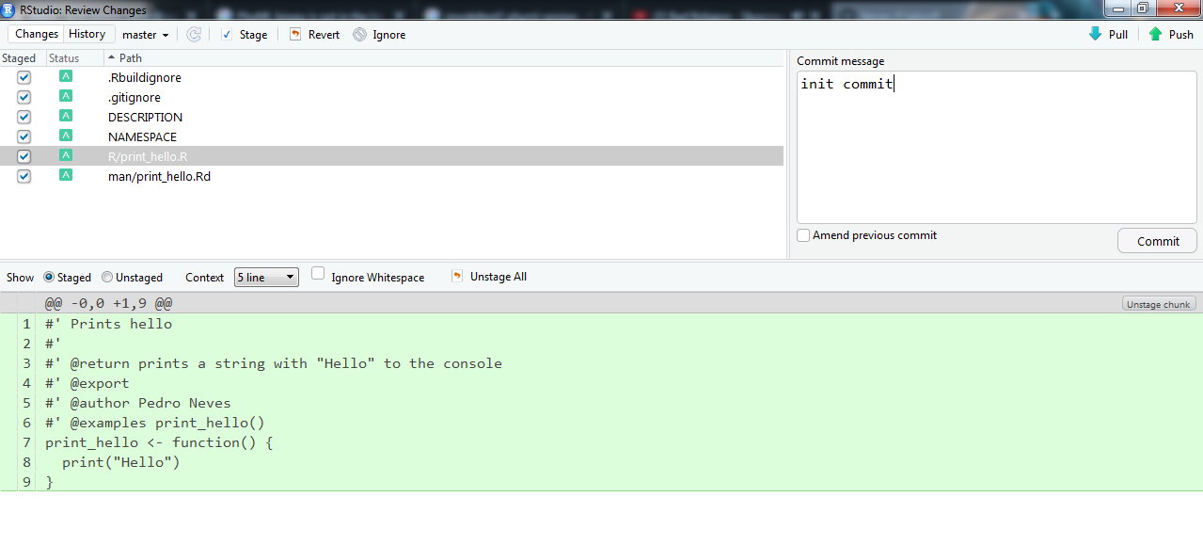
Review changes panel
3
1
2

Slide 24
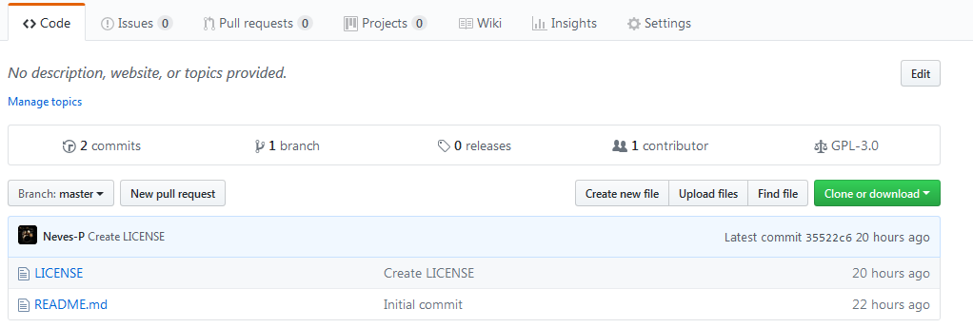

Slide 25
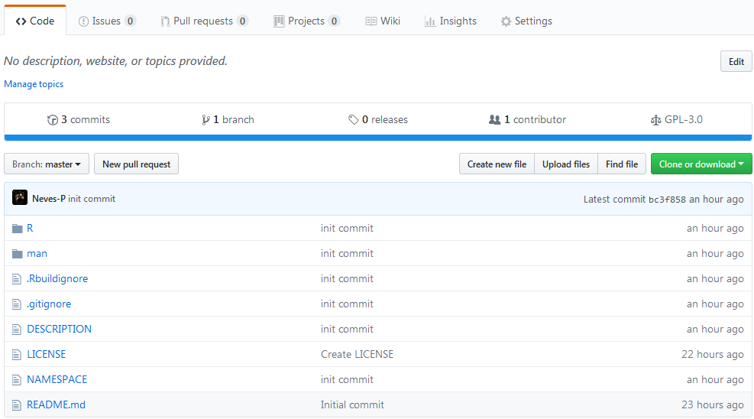

Slide 26
Working on a project already available on GitHub

Slide 27
Downloading (cloning) an existing repository

Slide 28
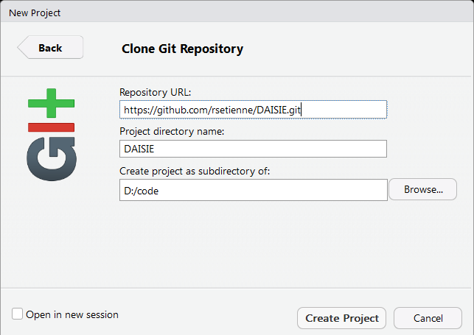
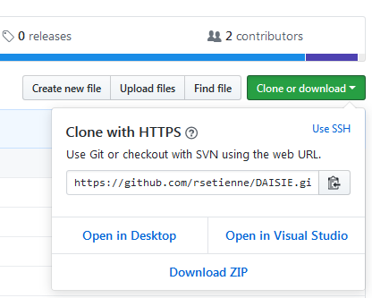
Cloning a repository
Copy your new GitHub repo’s URL to the Clone Git Repository Window in RStudio. GitHub will give you the right address, it should end in .git
Choose a directory on your local computer where the local files will live

Slide 29
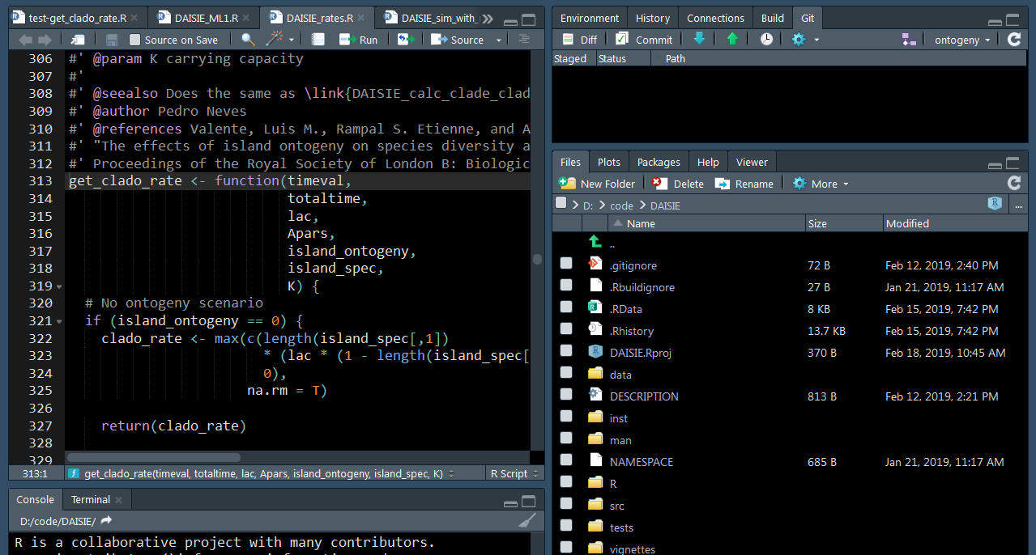
Start working!

